Slide 1

Covid-19 in the Philippines

Slide 2
Introduction Covid-19 (Although it doesn't need any)
My Country Republic of the Philippines, is one of the high-risk countries from the Wuhan coronavirus outbreak, recorded the first death outside China. The government has announced lock-down of Metro Manila and is mulling over more localised lock-downs as the nCoV cases increase gradually and the WHO declaring coronavirus as a pandemic.

Slide 3
Problem Which Tried to Solve: COVID-19 is wreaking havoc across the globe!!!
Well, that's something everyone probably already knows as long as they aren't living under the cave for some reason.
But is it really China who's the most affected right now?
Or one of those European countries that are literally on fire at the moment because of the virus?
How good is the US doing?
How on Earth did it spread so far? (See for yourself)
Will a public lockdown work?
Lessons to learn from China?
Should we be worried?

Slide 4
The Location and The Audience
The Philippines and the World
Everyone specially the Filipinos

Slide 5
The Data
The data below are gather from the COVID-19 repository by Johns Hopkins CSSE
The data below are downloaded from Kaggle Novel Coronavirus Philippine Dataset

Slide 6
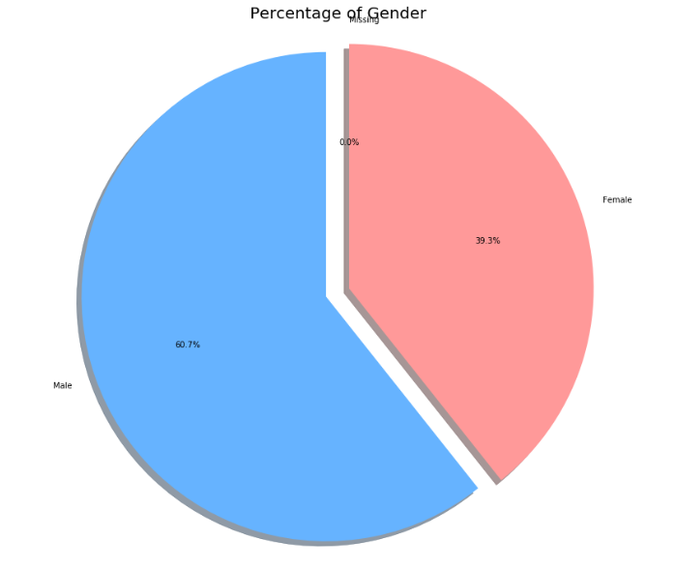
Gender Analysis
60.7% of COVID-19 positive patients are male. Men are the most most likely affected.

Slide 7
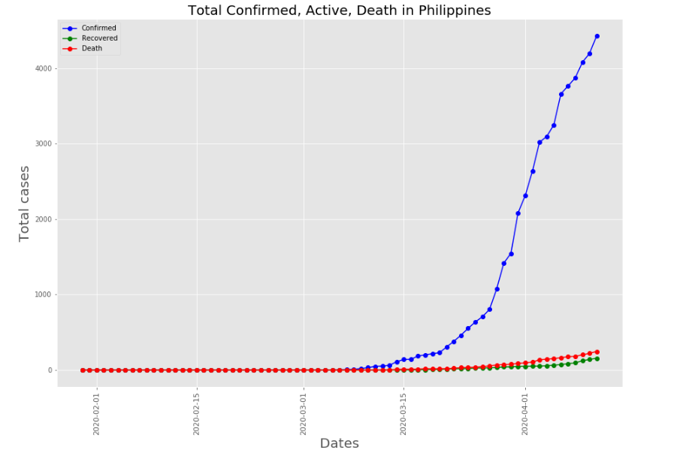
The Philippines vs the other countries

Slide 8
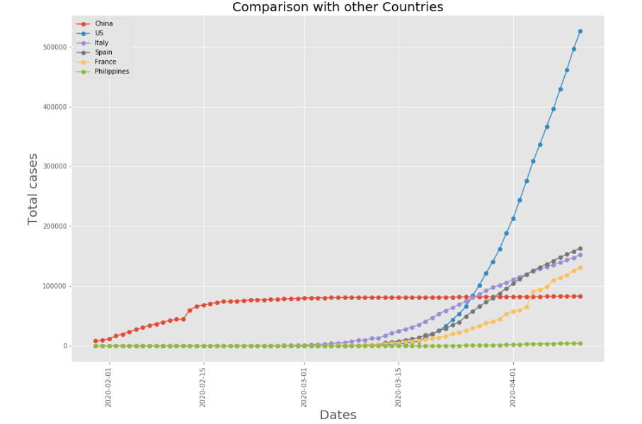
The Philippines vs the other countries

Slide 9
Though being highly populated the relative confirmed cases of Philippines is low compared to other countries. This could be because of two reasons
One month Enhanced Community Quarantine imposed by Pres. Rodrigo Duterte
Low testing rate

Slide 10
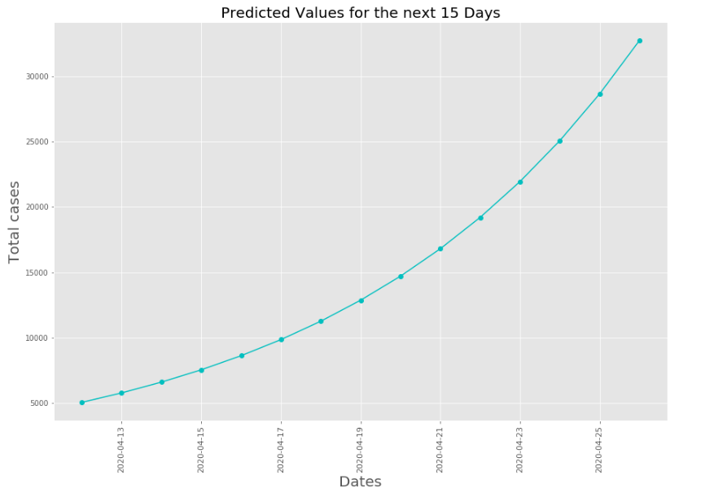
Prediction
We could see that the graph is increasing exponentially if the average growth factor doesn't decrease. It is important that the growth factor is reduced to flatten the curve.

Slide 11
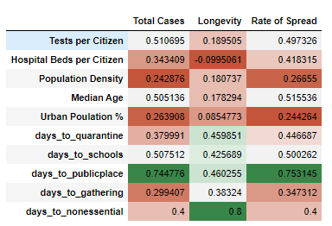
Correlating the Metadata

Slide 12
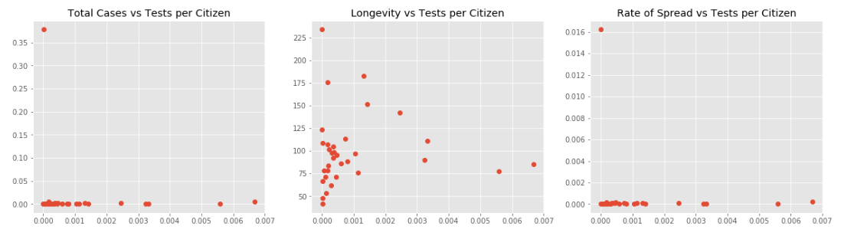
Correlating the Metadata

Slide 13
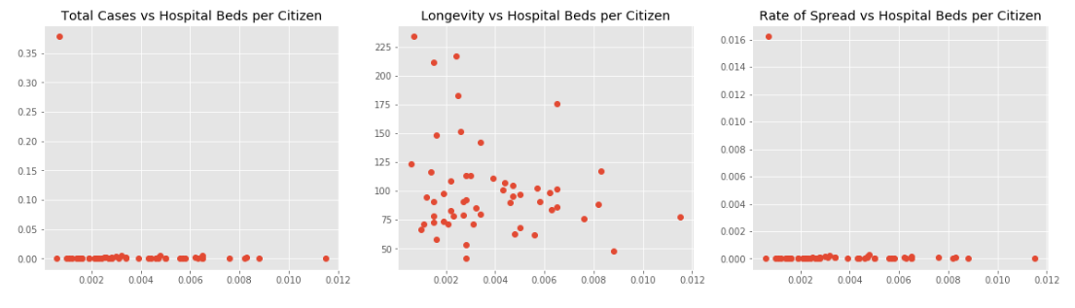
Correlating the Metadata

Slide 14
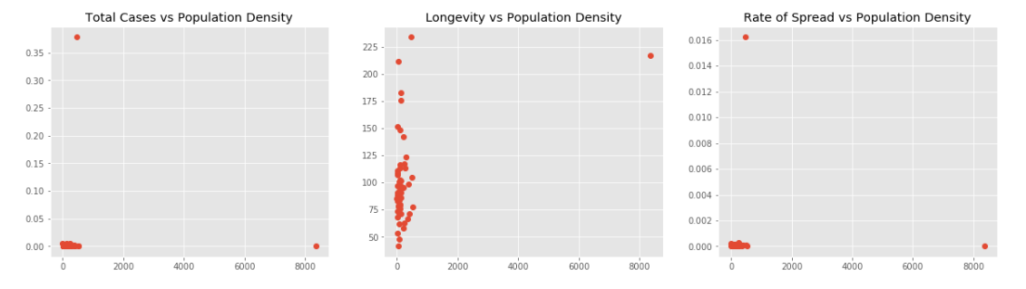
Correlating the Metadata

Slide 15
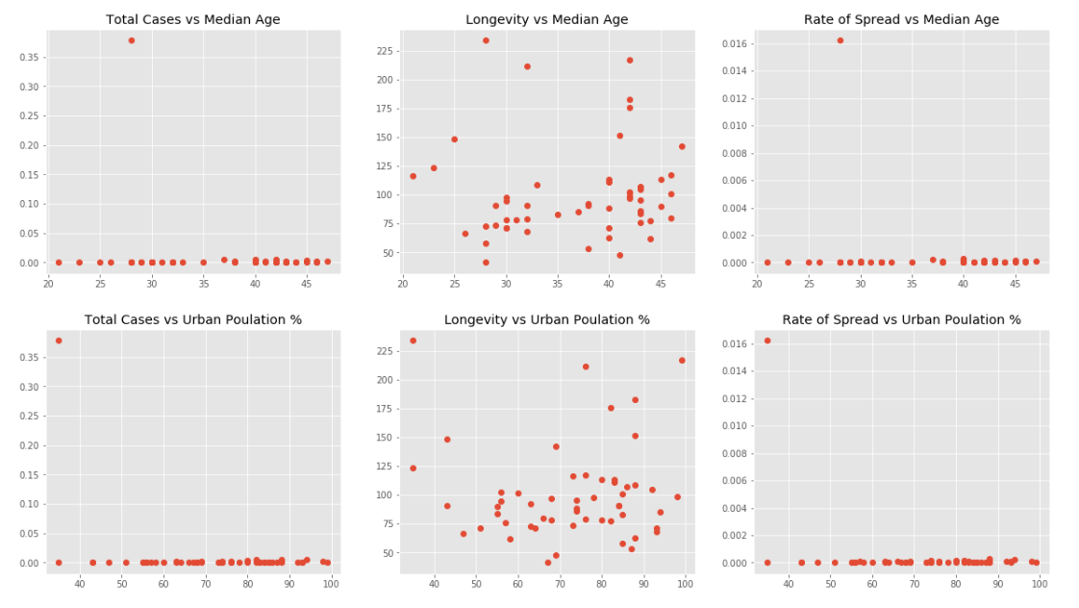
Correlating the Metadata

Slide 16
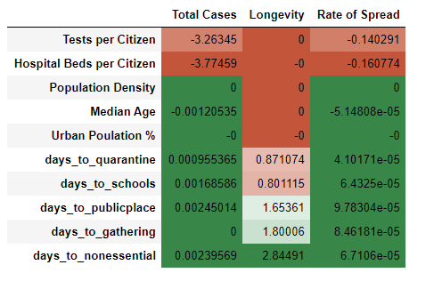
Correlating the Metadata

Slide 17
Summary Several factors were found to have a significant correlation with the impact of the virus, though none of the correlations were overwhelmingly strong. Faster enacted restrictions on movement have the biggest influence. Here are the main factors that were found to reduce the impact of COVID-19:
Schools Closed
on average one day delay lengthens the impact by 1.1 days, and means means 110 more people per million will become confirmed cases
Public Venues Closed
on average one day delay lengthens the impact by 2.0 days, and means means 140 more people per million will become confirmed cases
Social Gatherings Banned
on average one day delay lengthens the impact by 2.1 days, and means means 150 more people per million will become confirmed cases

Slide 18
Summary Several factors were found to have a significant correlation with the impact of the virus, though none of the correlations were overwhelmingly strong. Faster enacted restrictions on movement have the biggest influence. Here are the main factors that were found to reduce the impact of COVID-19:
Non-Essential House Leaving Banned
on average one day delay lengthens the impact by 3.0 days, and means means 150 more people per million will become confirmed cases
Higher temperature
On average one degree celcius higher means 6 fewer people per million will become confirmed cases
Lower humidity
On average one percentage lower humidity means 20 fewer people per million will become confirmed cases
Lower median age
On average one year higher median age means 5 fewer people per million will become confirmed cases

Slide 19
Thank you !!!

